Slide 1
Data Science/Engineering
Notes:
Intros to officers. OFFICERS ARRIVE 15 MINS EARLY

Slide 2
Basics
Source and refine training data for the project
Build data pipelines for storing, aggregating, and processing data
Transform raw data into usable formats (images into processable structures)
Coordinate with other teams to ensure access and efficacy of data
Validate the efficacy of the model
Notes:
Josh talk about Bot if finished?

Slide 3
Timeline
2 weeks
2 weeks
2 weeks
2 weeks
4 weeks
1 week
Understanding the Basics
Building on our knowledge
Design
Development
Document and Present
Detailed Requirements Drafting and Prototyping
What core knowledge do you need to cover?
Create an actionable plan for the “how.” How will the images be processed, aggregated, etc
Design, validate, build, verify
Document lessons learned, accomplishments, and share your discoveries with The Boring Club and the UW community
How can this knowledge start being applied to the pipeline/data
What will be the exact role of this subteam? Start collecting data and prototyping the pipeline

Slide 4
Next Steps
Make a copy of the Google doc and use the prompts as a stepping stone for further research
Try to find reliable sources to provide answers for the prompts and other questions and paste them in your copy of the Google doc.
Feel free to add questions as you go

Slide 5
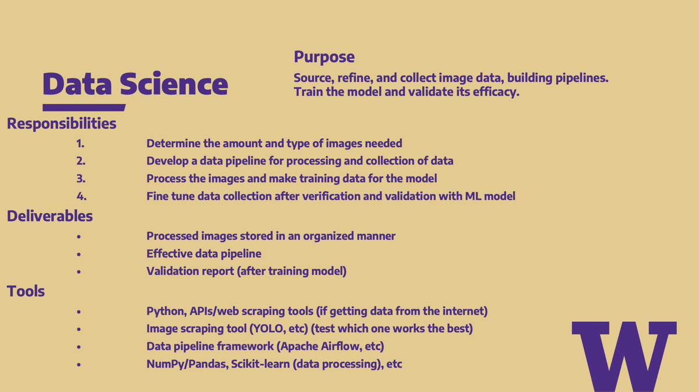

Slide 6
Thanks for coming!

